Slide 1


Slide 2





Thank you to our hackathon sponsors who made this possible!

Slide 3
Photography and recording
Disclaimer – if you do not want your photo or video taken during this hackathon, please speak to a facilitator asap.

Slide 4
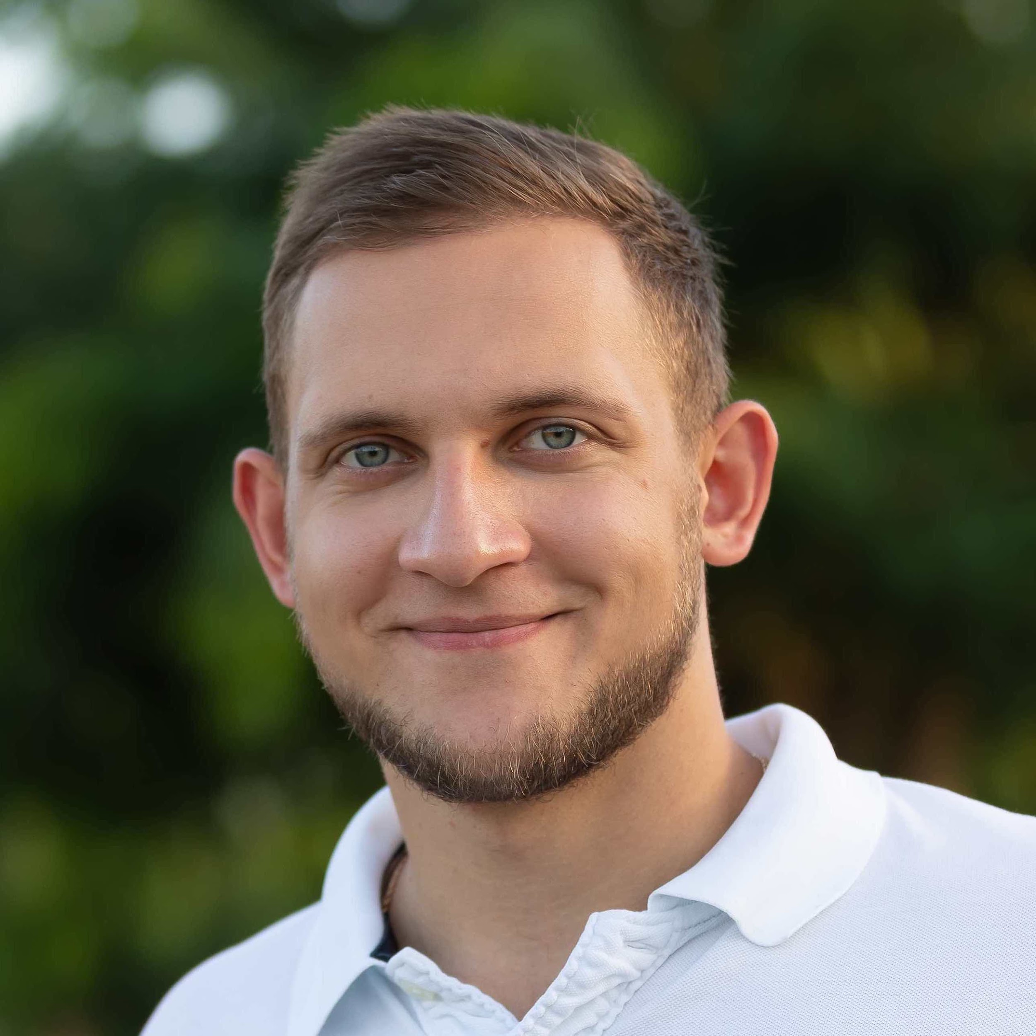
Meet your facilitators – Oleg and Clement
Oleg Ovcharenko (NVIDIA)
Oleg is Solutions Architect for Energy at NVIDIA. He received his Ph.D from KAUST where he was exploring data-driven methods for the initialization of full-waveform inversion. Oleg is broadly interested in HPC and deep learning applications in geophysics.

Slide 5

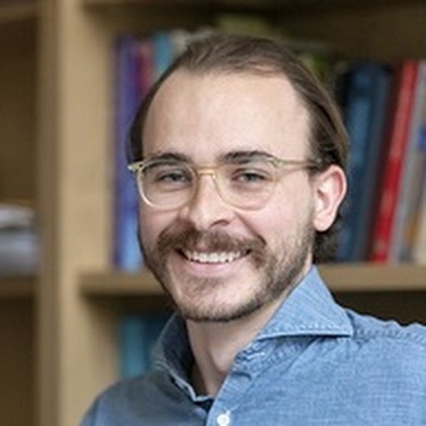
Meet your facilitators – Ashley and Lukas
Ashley Russell (Equinor ASA)
Leader for Data Science and Analytics for subsurface in Equinor. Geologist, self taught data scientist, expertise in Python, data visualization, including interactive plotting and dashboarding, statistics, and machine learning.
@ashleyr (softwareunderground) aruss@equinor.com
Lukas Mosser (Aker BP ASA)
Lukas Mosser is an Advanced Data Scientist at Aker BP. He currently leads Aker BPs efforts around conversational AI. Lukas received his P.h.D from Imperial College London, where he worked on stochastic reconstruction of porous media and geophysical inverse problems using deep learning. He currently also serves as a member of the EAGE AI committee.
@porestar (twitter) @lmoss (softwareunderground) lukas.mosser@akerbp.com

Slide 6
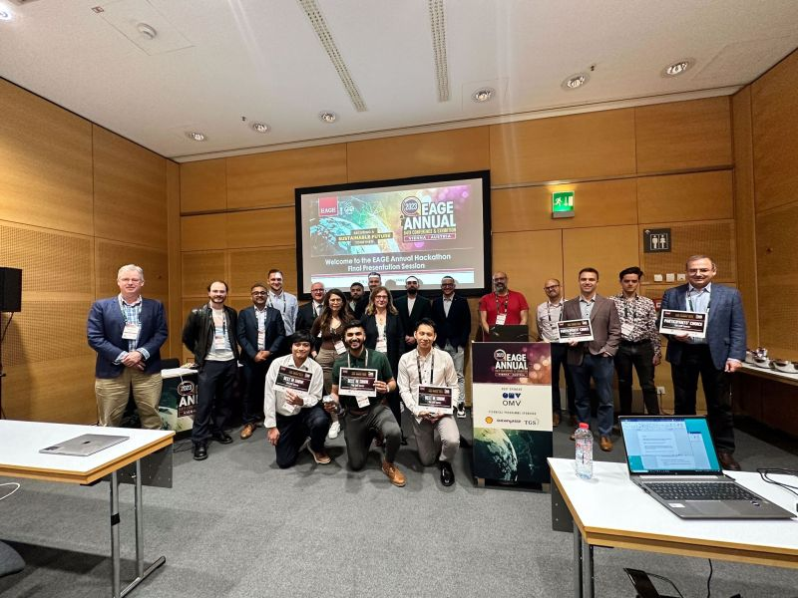
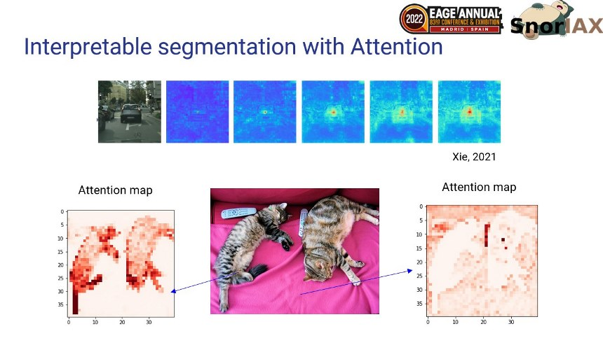
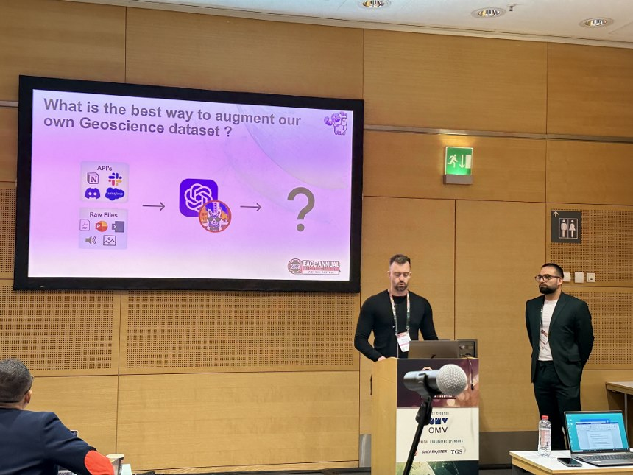
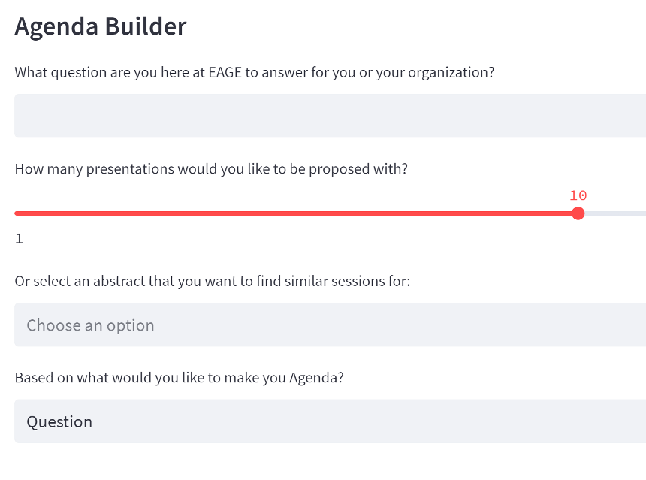
Hackathon History at the EAGE
Past Themes:
Madrid (2022): Explainable AI
Vienna (2023): Natural Language Processing

Slide 7

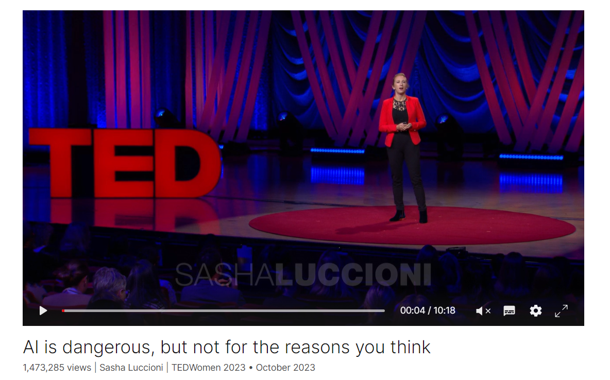
Why this theme?
“That cloud that AI models live on is actually made out of metal, plastic, and powered by vast amounts of energy. And each time you query an AI model, it comes with a cost to the planet.
Last year, I was part of the BigScience initiative,
which brought together a thousand researchers
from all over the world to create Bloom, the first open large language model, like ChatGPT, but with an emphasis on ethics, transparency and consent. And the study I led that looked at Bloom's environmental impacts found that just training it used as much energy as 30 homes in a whole year and emitted 25 tons of carbon dioxide, which is like driving your car five times around the planet just so somebody can use this model to tell a knock-knock joke. And this might not seem like a lot, but other similar large language models, like GPT-3, emit 20 times more carbon.” – Sasha Luccioni

Slide 8
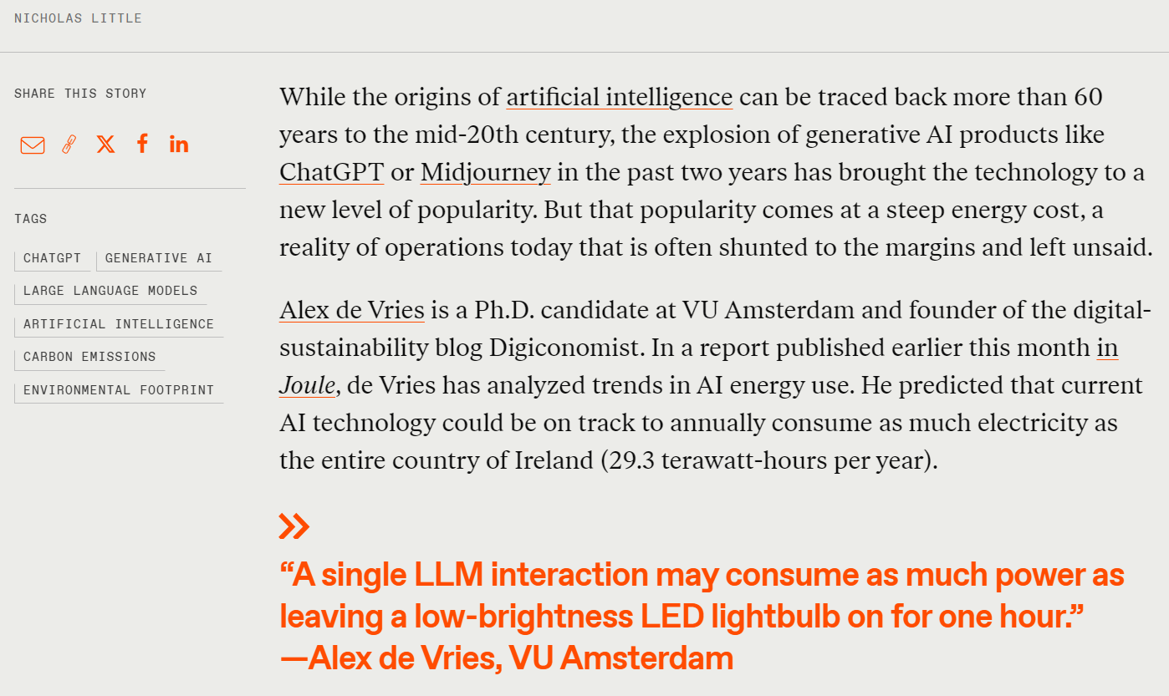
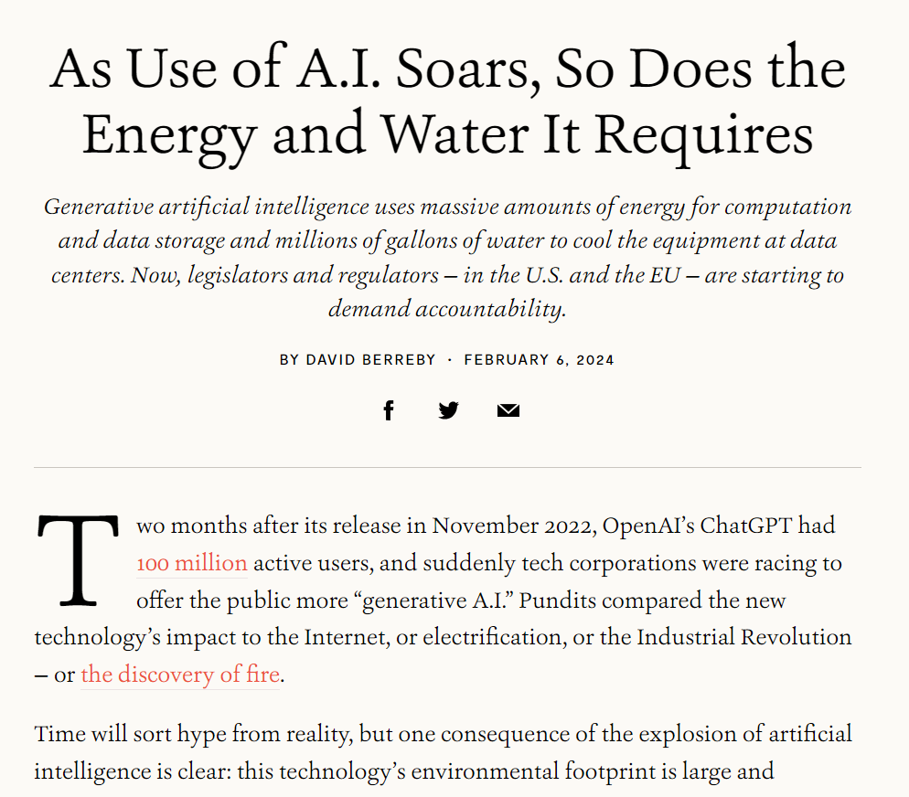
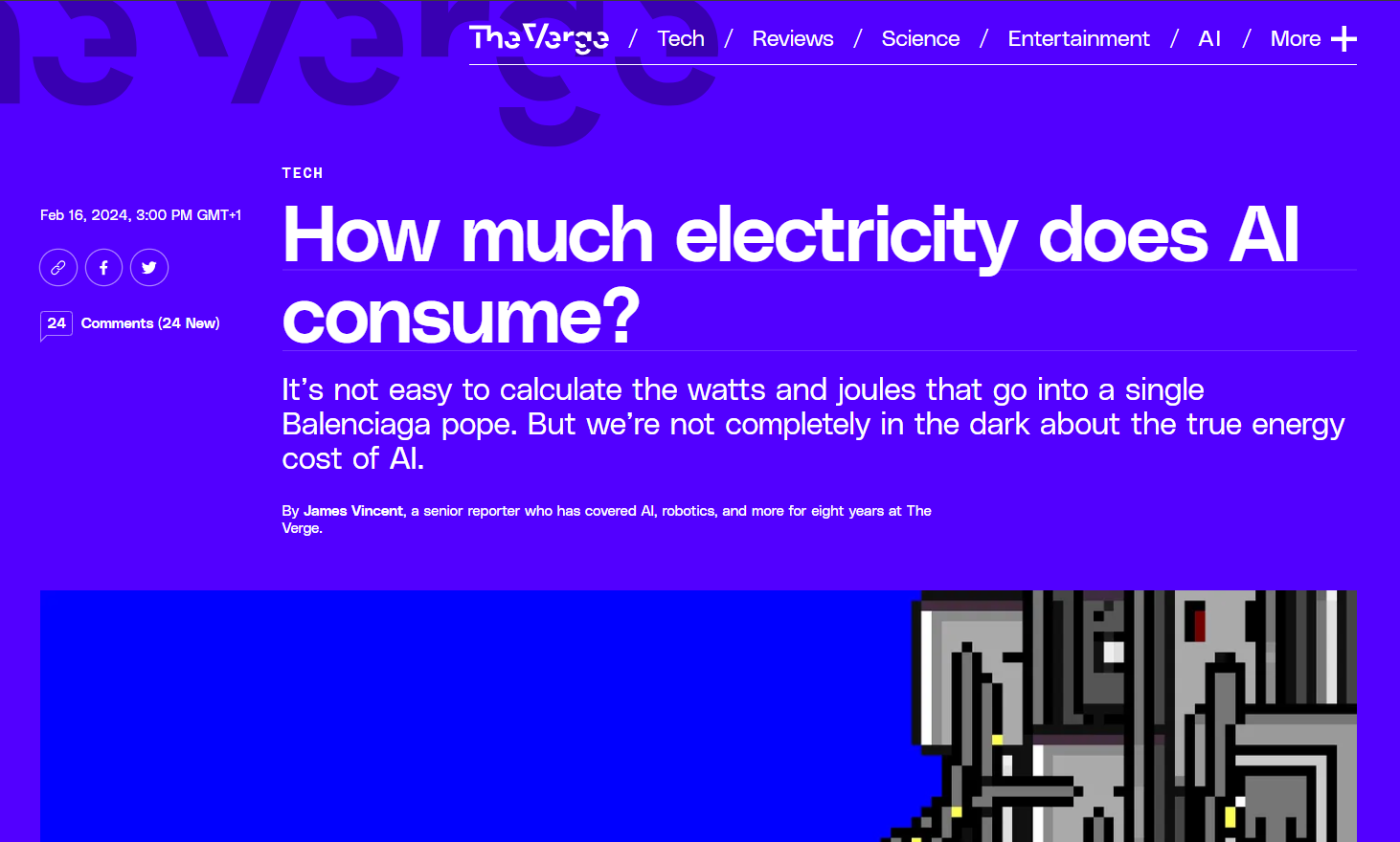
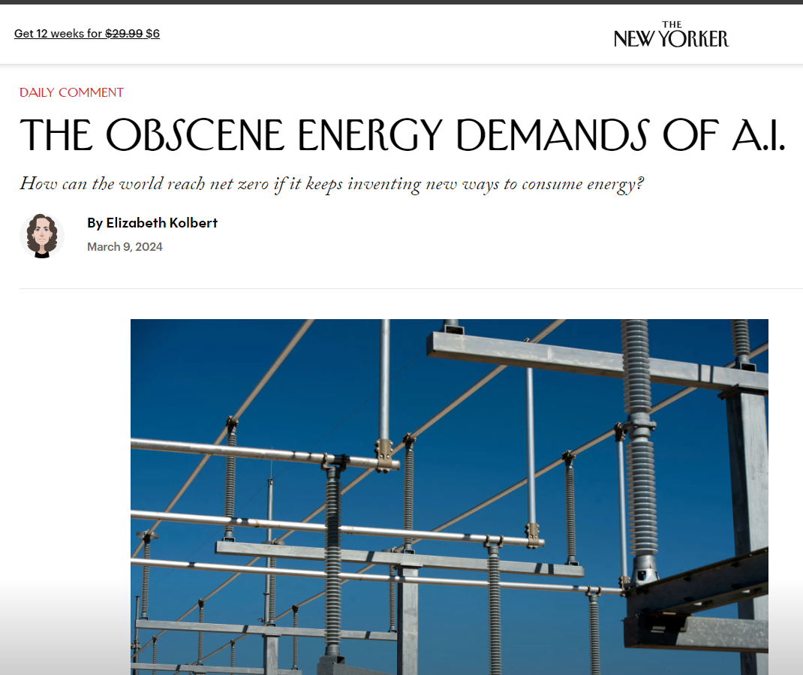
Why this theme?
Notes:
https://e360.yale.edu/features/artificial-intelligence-climate-energy-emissions
https://www.newyorker.com/news/daily-comment/the-obscene-energy-demands-of-ai
https://www.theverge.com/24066646/ai-electricity-energy-watts-generative-consumption
https://spectrum.ieee.org/ai-energy-consumption
Expectations to you on of course having fun today – but think about how you will deomonstrate that your solution is more sustainable either in lines of code, compute time, electricity usage, removal of CO2…etc than how it works today. This is fundamentally the challenge we are giving you.

Slide 9
Agenda
☕👩‍💻☕🥪👩‍💻☕☕☕🥪🥵🙌🙋‍♀️🤩
Day 1: Sunday, June 9
Day 2: Monday, June 10
9:00 - 9:30 CEST - Welcome and coffee 9:30 - 10:30 CEST – Introduction 10:30 – 11:00 CEST – Project and team discovery time 11:00 - 18:00 CEST - Hacking all day
- Lunch and beverages will be delivered to the room ☺
9:00 - 9:15 CEST - Welcome and coffee 9:15 – 12:00 CEST – Hacking
- Lunch and Beverages will be delivered 12:00 CEST: CODE FREEZE – Instructions for the next step 12:15-14:00 CEST – Time for working and practicing presentations 14:00 – 15:15 CEST - Presentations to the Judging Panel 15:15 - 15:45 CEST - Announcement of the winners and prizes*
Winning presentations will present at the Energy Transition Theatre: Tuesday 11th 14:30

Slide 10
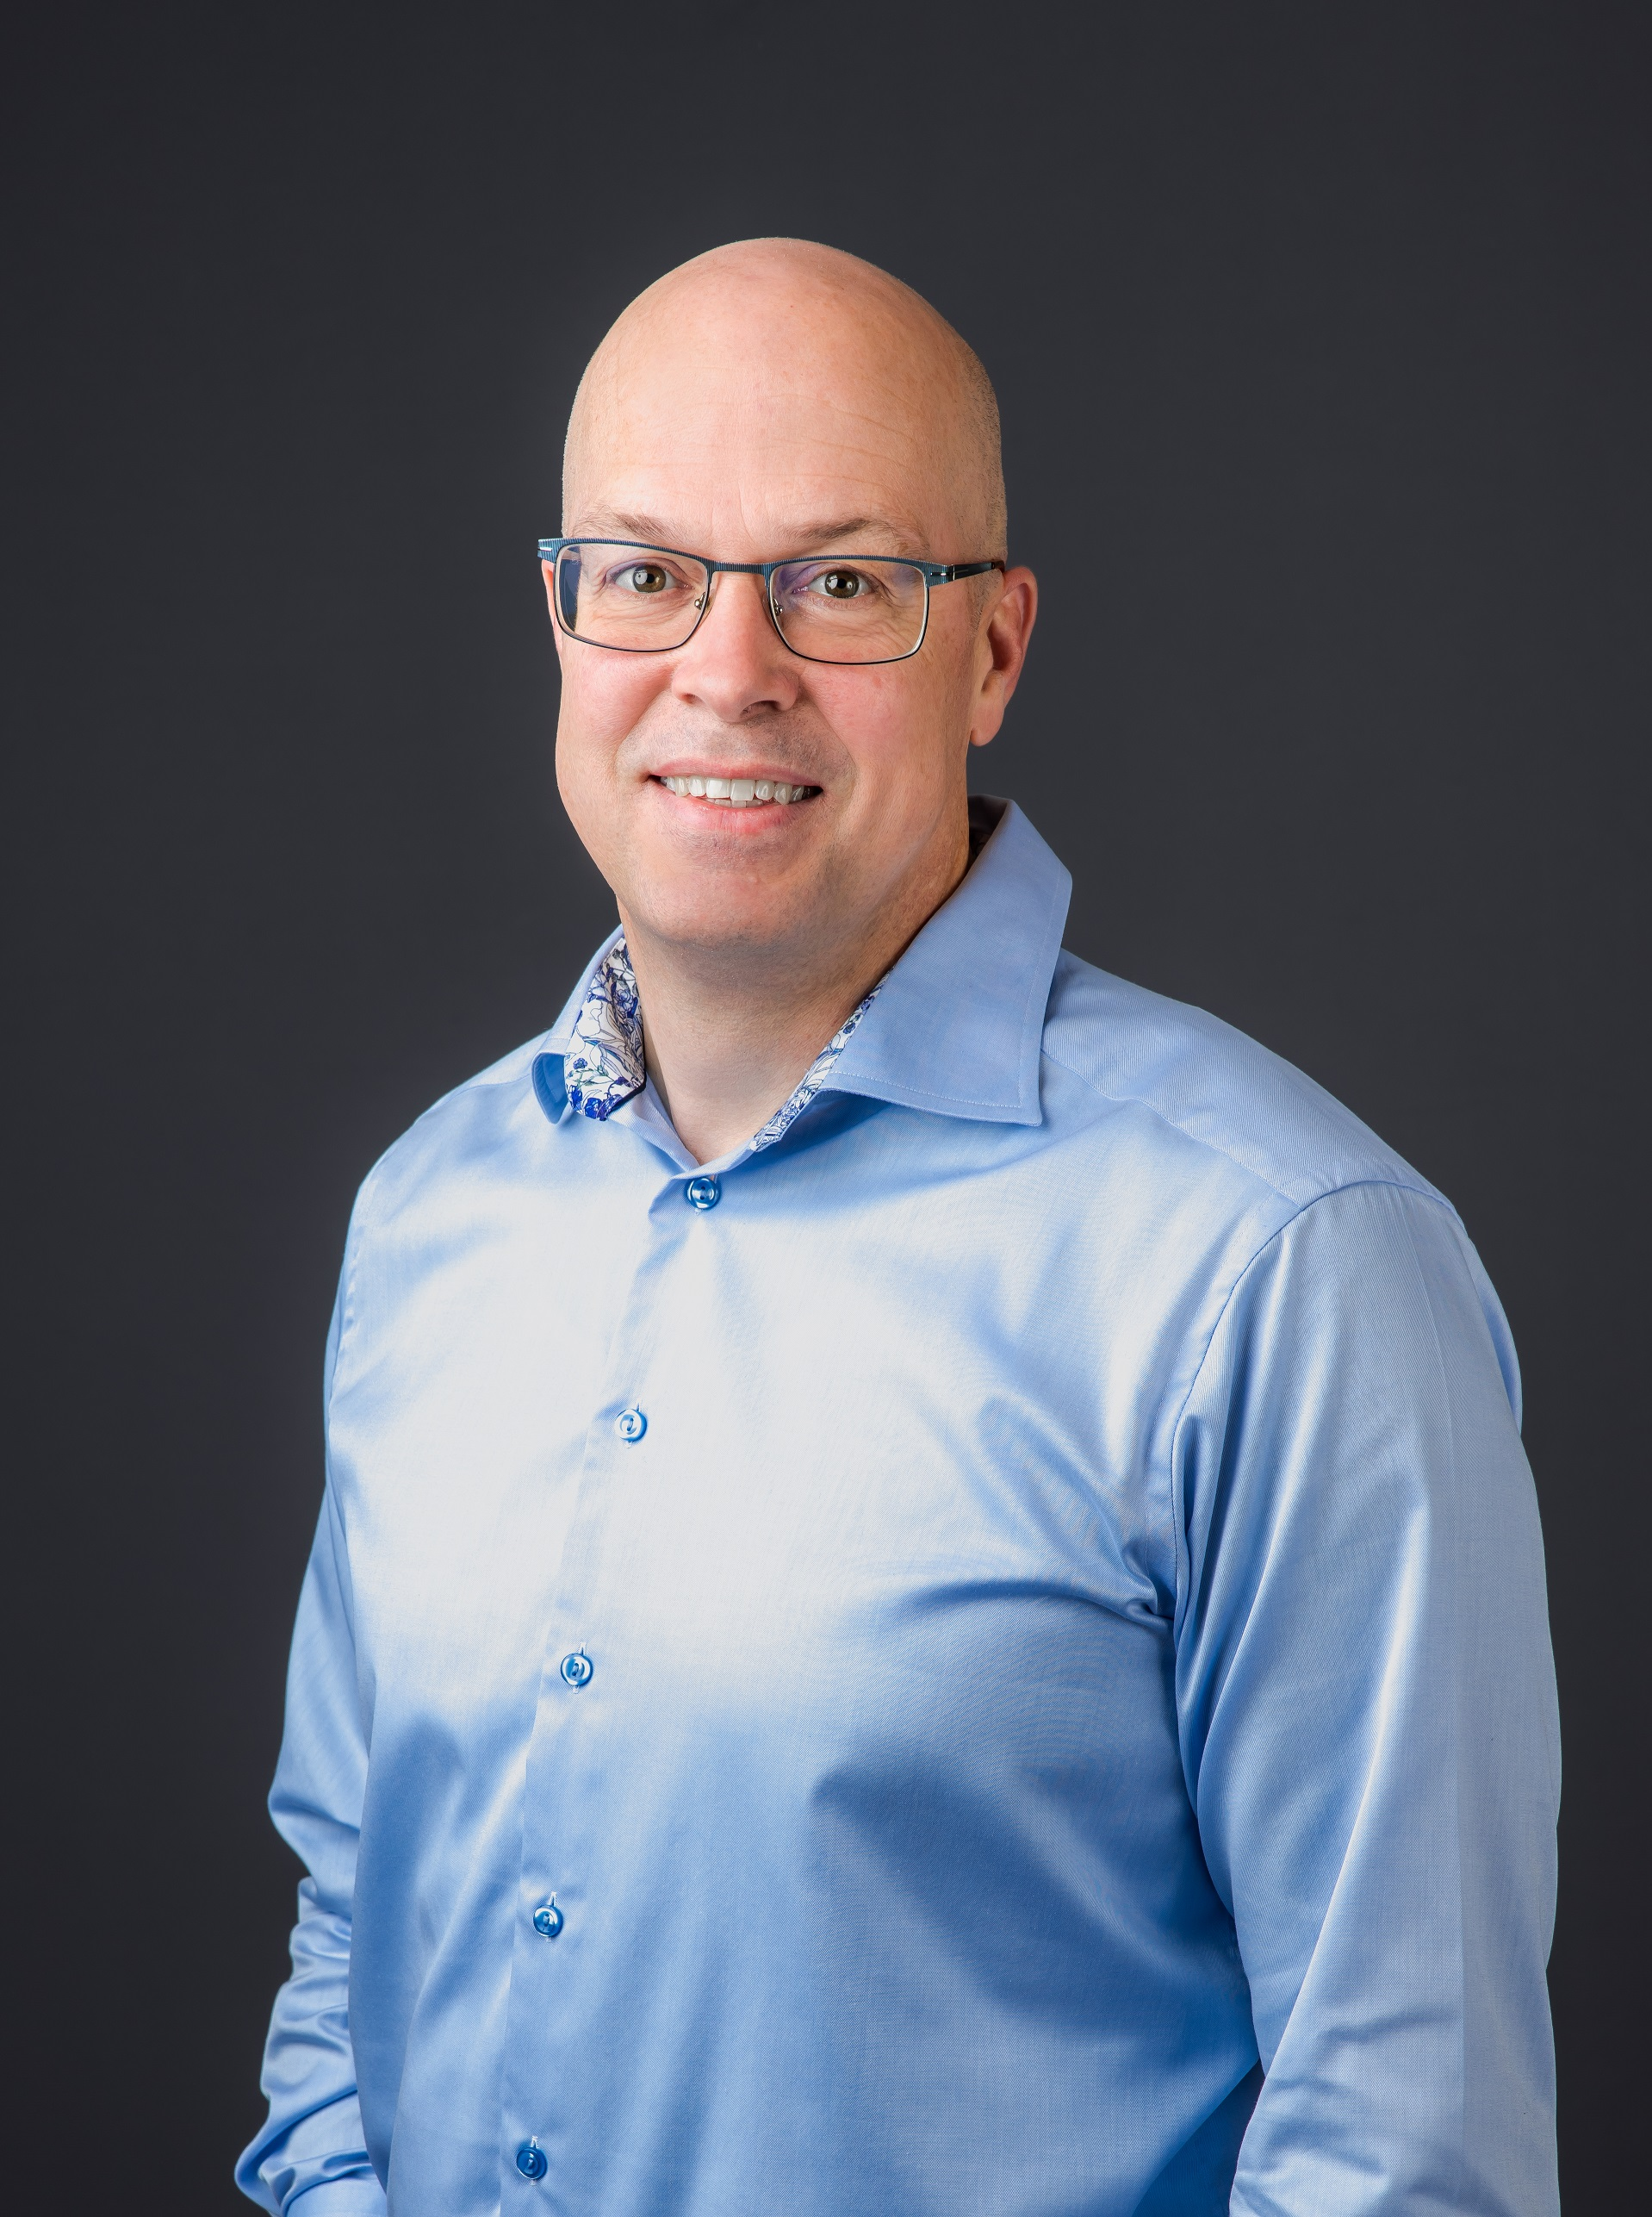
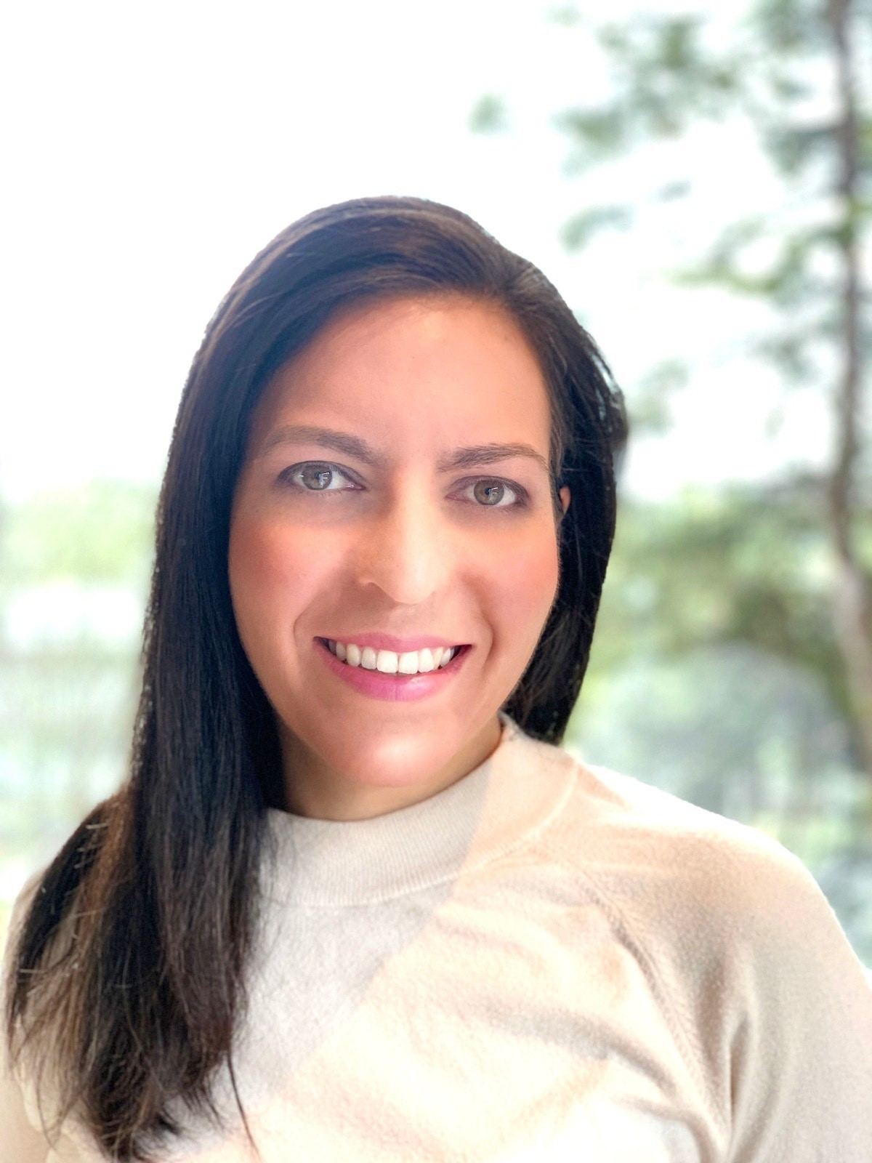
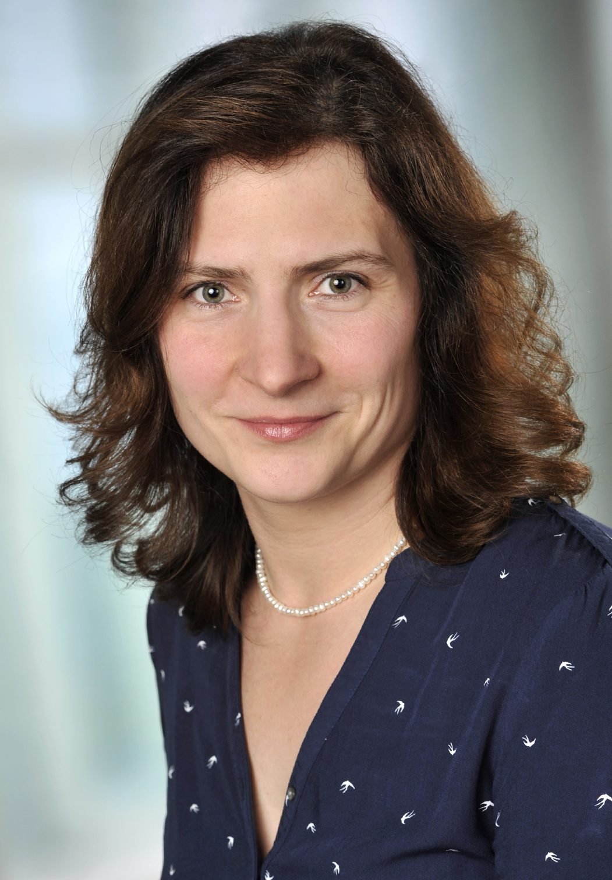
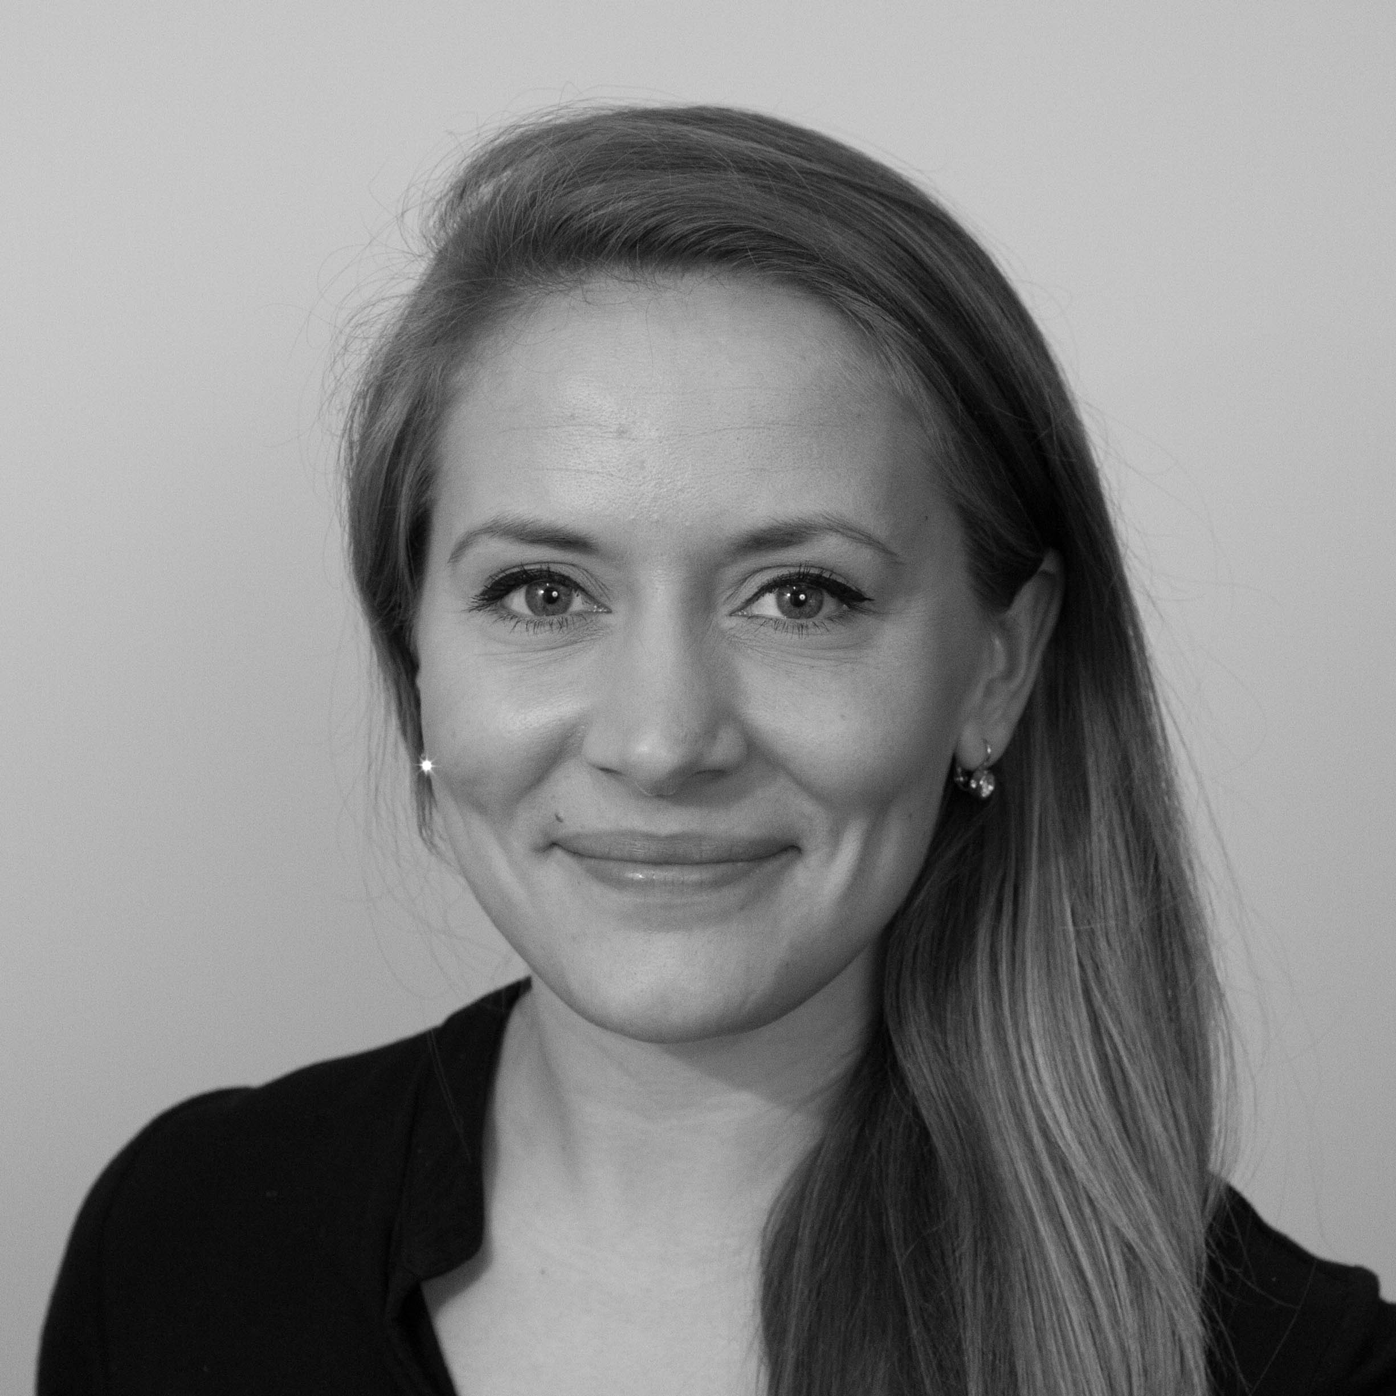
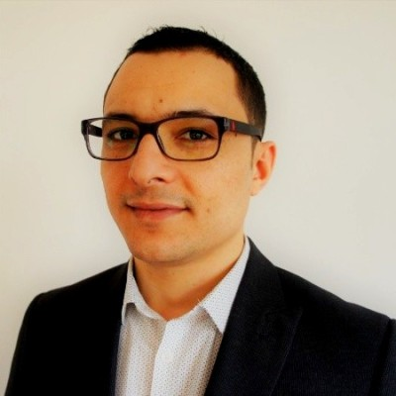



Judges Panel:
Guido van der Hoff
Maria Eugenia Diaz Rodriguez
Nicole Grobys
Aina Juell Bugge
Issam Said
Business development manager for digital subsurface for Europe and Africa
Senior Geophysicist, Field development and CCS
Geophysicist and data scientist
Manager, Solutions Architecture and Engineering for Energy
Subsurface Leader for Gullfaks C

Slide 11


Awards!
There are two awards up for grabs.
These two teams will have their final presentations in the Energy Transition Theatre during the annual meeting!
Best in Show – chosen by a panel of judges
Audience Choice – Chosen by you!

Slide 12
Prize!

Slide 13
Github expectations
All teams are expected to upload their code and presentations to a Github Repo within the EAGE-Annual-Hackathon team.
You will find these slides, instructions, agenda in the EAGE-2024-Hackathon-Instructions Repo.
A list of resources with links is in the Discussion Boards.
If you need any help working with Github – just ask a facilitator!

Slide 14
Some General Recommendations
Be mindful towards others and yourself.
Ask for help
Interact with other teams
Try to close the loop early. Data>Baseline>Test>Measure>Learn
One key item, is better than 100 half-baked things
Focus on things that will get your idea across
Keep it simple, s**** (KISS)
Get to know your teammates, play into your strengths
Maximize learning, over winning. Learning *is* winning.
Presentation is key and framing to the theme
Dare to go your own way: Every hackathon, project, team, and individual are unique.
Source: Accumulated Hackathon Experience

Slide 15
Some Hackathon Tips
Take screenshots as you go along – this will save a lot of time when you come to preparing the final presentation
A little planning goes a long way – post its to organize your work or making a list can help keep focus. Github Issues is a way to digitally keep track as well.
By the end of the day today you should at a minimum have settled on a specific case, sketched out a plan, and have started some work.
Ensure you are addressing the theme of the hackathon!

Slide 16

Reminder: Hackathons aren’t about getting a perfect solution or answer – it is about trying something new, being bold and learning along the way

Slide 17
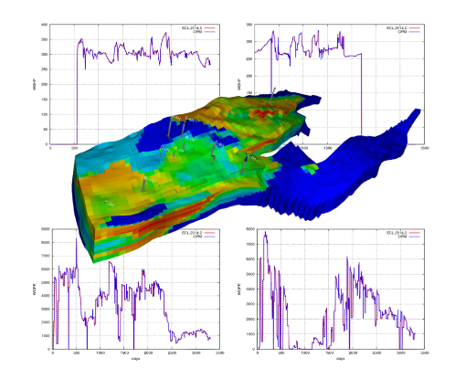
Data and Tool Resources
You will find a detailed list of data and tool resources in the Github Discussion Boards.
Reservoir Modeling:
ResSim Simulator
Modulus Physics-ML
LLM Fine Tuning:
Data and processing scripts for EAGE abstracts
Example for LoRA fine-tuning for Llama
Field Datasets:
Norne
Marmousi
Volve
Smeaheia
Common open source packages:
Subsurface
The Norne Dataset from OPM – linked to the left.

Slide 18
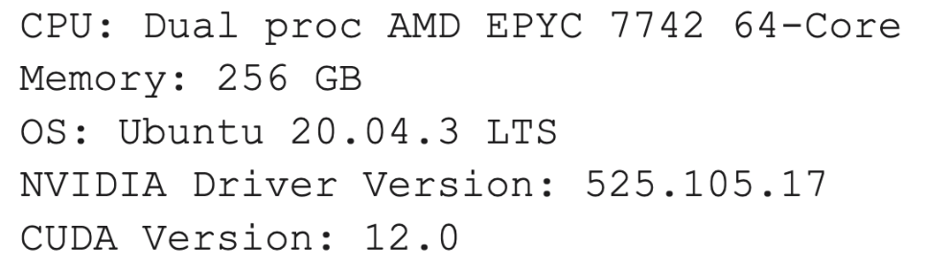
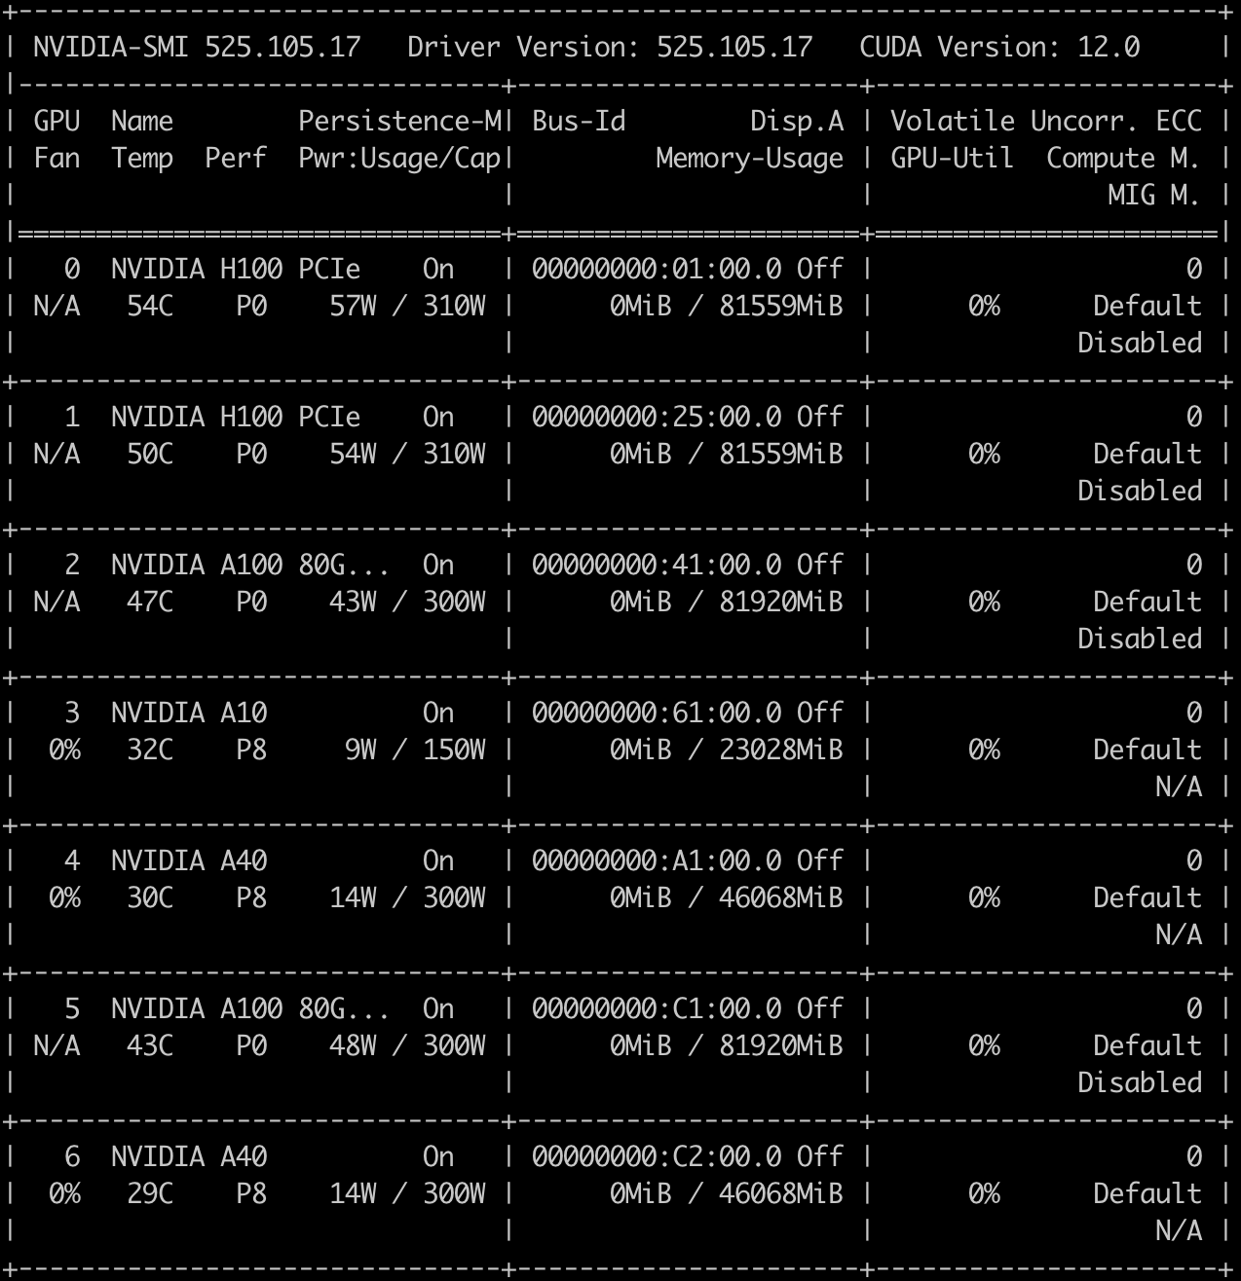
GPU resources
Connect to login node:
ssh you_login@nvpoc.ddnsfree.com
Run interactive session:
srun --gpus N --pty bash -i
NVIDIA Docker Container Repository
https://catalog.ngc.nvidia.com/
Full details:
https://docs.google.com/document/d/1ce94uqAhiggMm9IQvgMElNZiI-T3XDTklsjPcpcv0qA/edit?usp=sharing

Slide 19
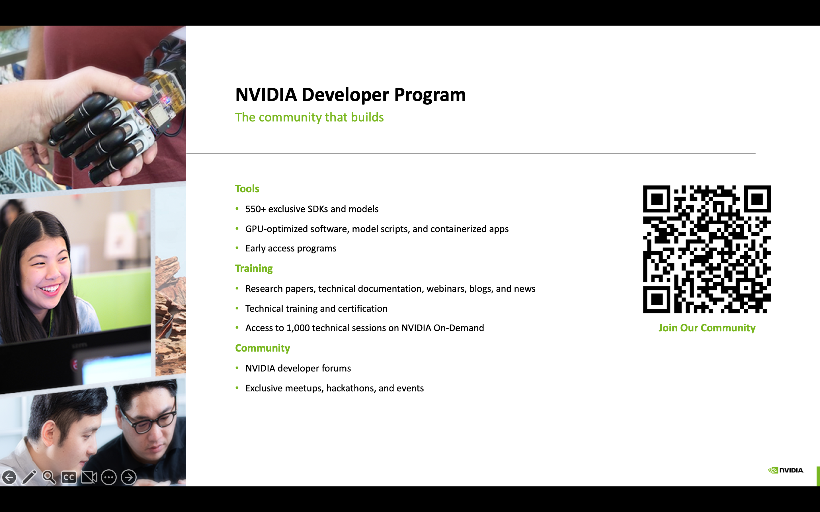

Slide 20
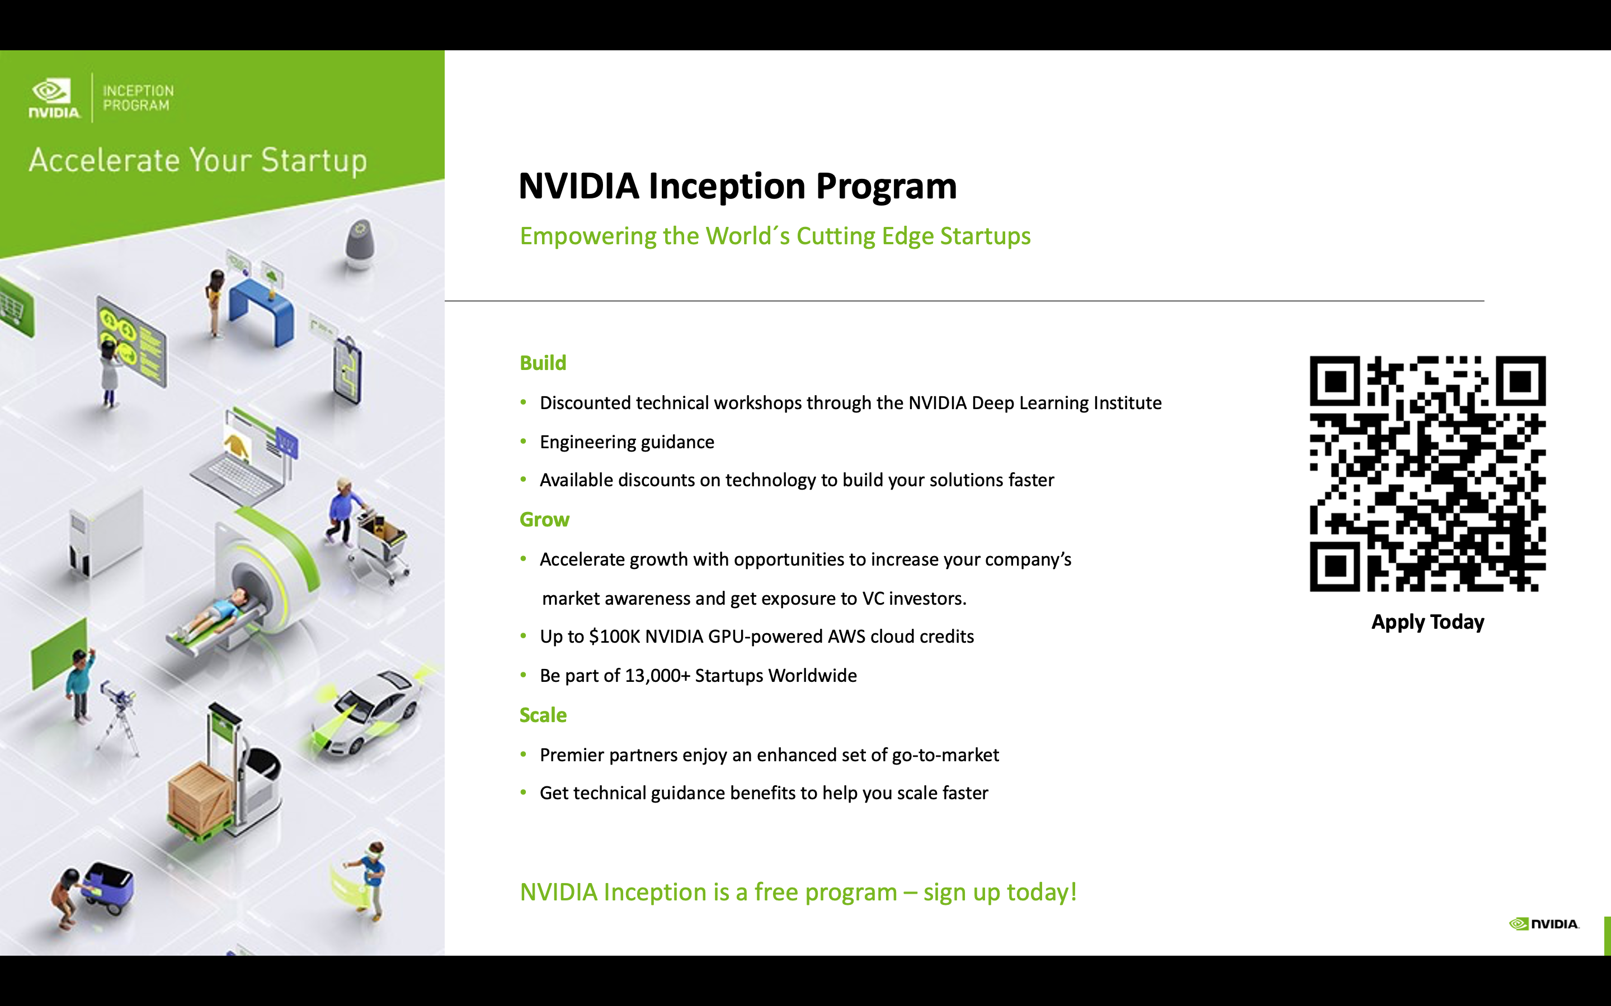

Slide 21
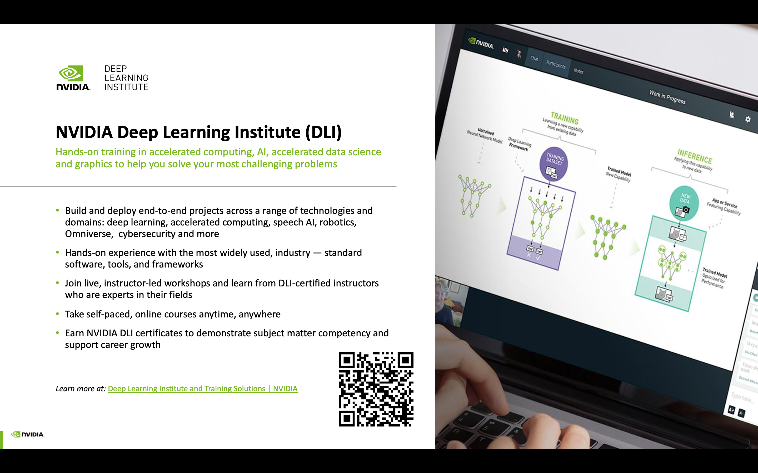

Slide 22
Ideas and Teams
Previously Mentioned Ideas
Any other ideas?
Benchmark LLM Questions – we don’t have a benchmark today
CCS or Oil and Gas Simulation – Less Compute
LLM Fine tuning on the EAGE dataset or another geoscience dataset
Optimize an existing open source code base to be faster
Predicting missing subsurface data for data-poor CCS licensing areas

Slide 23
Welcome to the Final Presentations!

Slide 24
Judges Panel:
Guido van der Hoff
Maria Eugenia Diaz Rodriguez
Nicole Grobys
Aina Juell Bugge
Issam Said
Business development manager for digital subsurface for Europe and Africa
Senior Geophysicist, Field development and CCS
Geophysicist and data scientist
Manager, Solutions Architecture and Engineering for Energy
Subsurface Leader for Gullfaks C

Slide 25
Judging Instructions and Criteria
Collectively as a group you will select a winner. These are the critera:
Relevancy to the theme of “coding to net-zero” (Did the presentation demonstrate the team’s ambition to make solutions more sustainable, energy efficient, or address challenges in low carbon? Did they use a benchmark or baseline (time, lines of code, number of computers..etc?)
Understandable, with good explanation of the challenge and the solution direction (meaning that the problem and solution were communicated for a more general audience)
Presentation skills and presentation quality (was there a demo? was the presentation engaging and flowed properly?)
*As a last point - note that some teams might not get to a working solution - do not judge them on this - but instead on the effort and ideas on approaching the challenge (what did they try, why did it fail, what would they do different?)

Slide 26
Final Presentation Guide
Each team will have 10 minutes for presentation and 10 minutes for Q&A from the judges and/or facilitators. We will be strict on time and will give you a 5 minute and 1 minute warning.
Your presentation can be slides/demos/mix – your choice! (But always bonus points for live demos!)
Make sure your final presentation (if slides) is also uploaded to your Github Repo.
You will present from your own computer.
Recommended that everyone on the team gets a chance to present something ☺

